Slide 1
Developing for Microsoft Teams
Notes:
This module introduces the Microsoft Teams service and explains the why and the how of creating Teams and Channels when rolling out Microsoft Teams in an Office 365 organization. The module also examines the Microsoft Teams developer platform and explains how to develop Microsoft Teams apps with custom tabs, bots, connectors and messaging extensions. Students will learn how to develop and test an app for Microsoft Teams using App Studio. Students will also learn to develop Microsoft Team apps using Visual Studio 2017 and C# as well as with Node.js, Visual Studio Code and the Microsoft Teams JavaScript Client SDK. Along the way, students will learn advanced development techniques with Microsoft Teams including developing custom messaging extensions and posting dynamic content to an activity feed.

Slide 2
Agenda
Introduction to Microsoft Teams
Developing with the NGROK Utility
Developing Static Tabs and Dynamic Tabs
Developing Tabs with Node.js, TypeScript and React.js
Getting Started with App Studio
Developing Incoming Webhooks
Developing Bots for Microsoft Teams

Slide 3
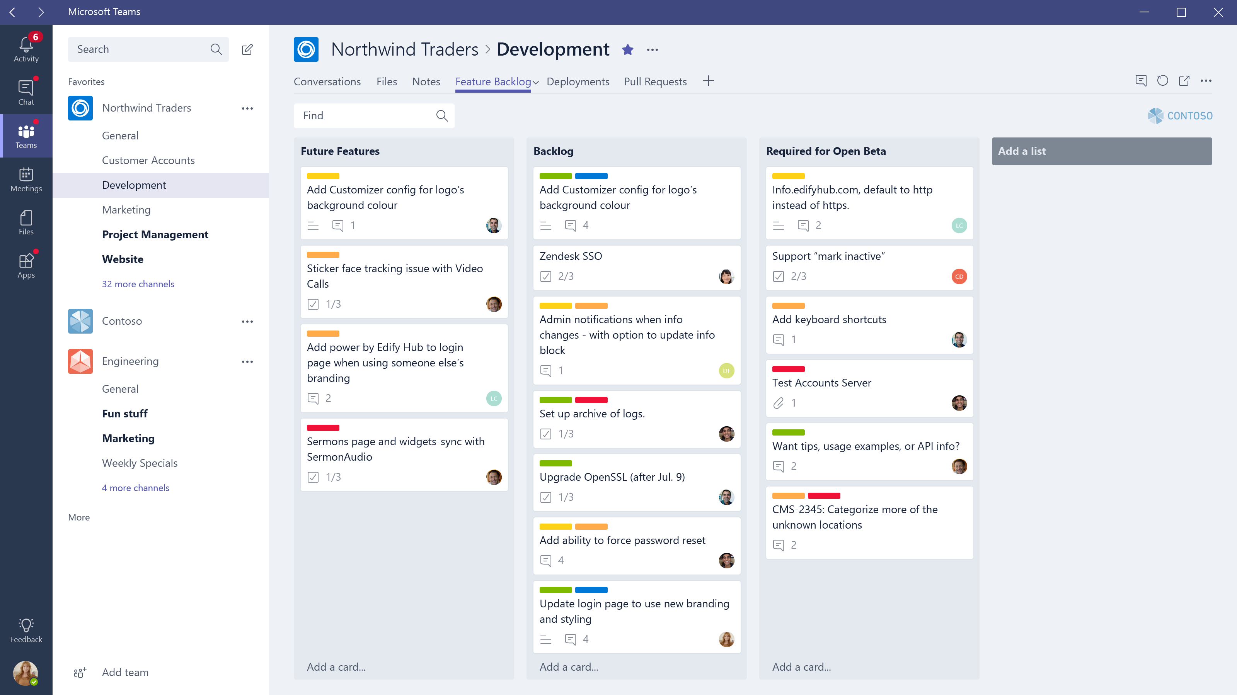
Introduction to Microsoft Teams
Microsoft Teams is a Chat-based Workspace Service
Based on an evolved version of Skype for Business
Created by Microsoft to compete against Slack
Provides deep integration with Office 365
Offers native apps for Windows 10, Mac, iOS, Android and Windows Phone

Slide 4
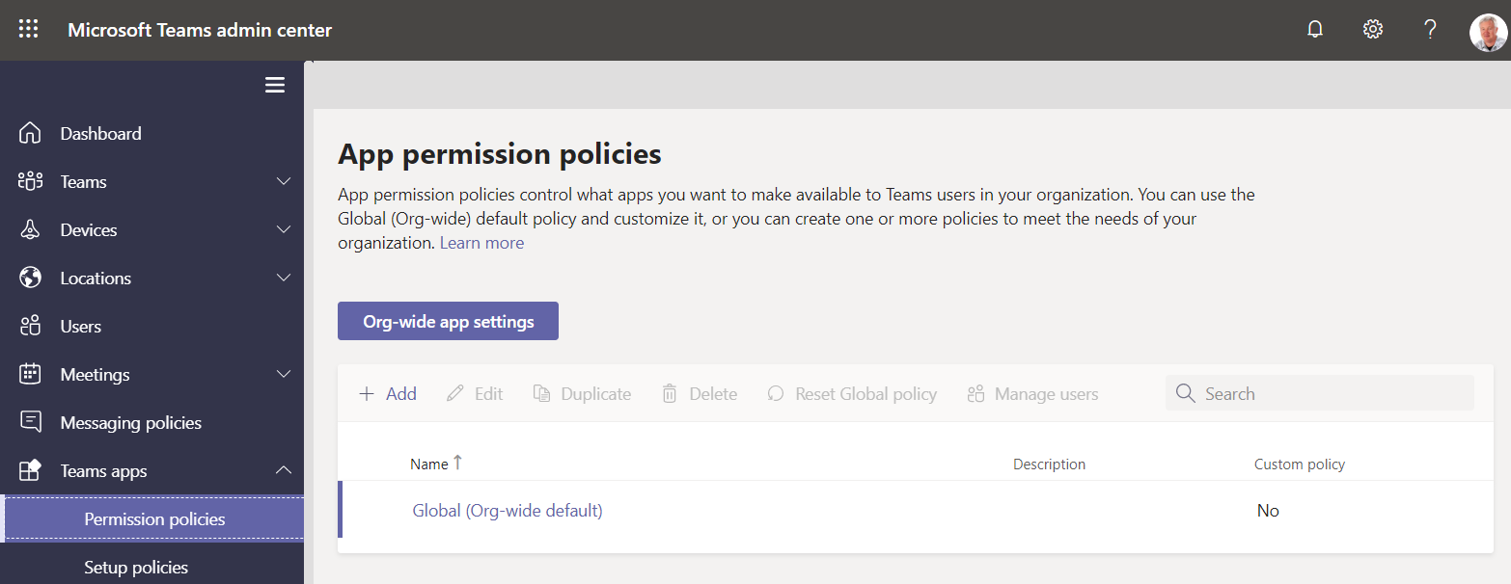
Microsoft Teams Admin Center
Microsoft has a new admin center
Located at https://admin.teams.microsoft.com
Used to manage teams and apps

Slide 5
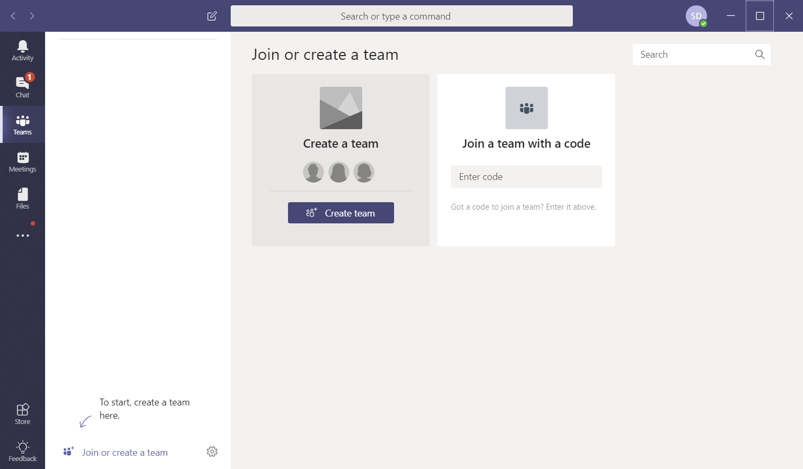
Creating a New Team

Slide 6
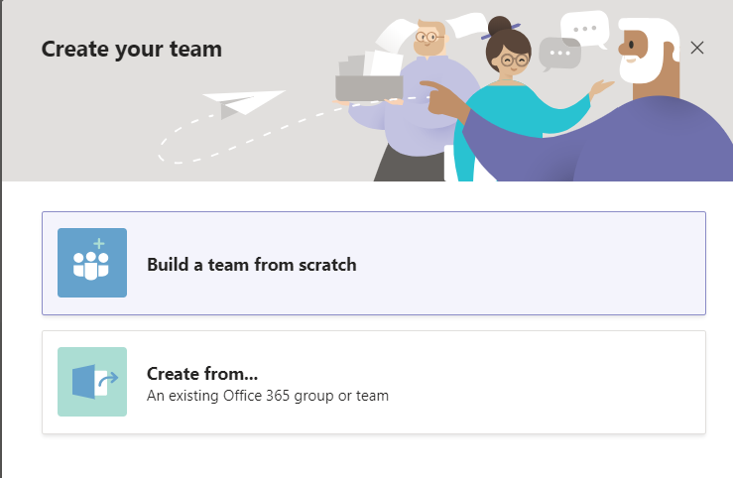
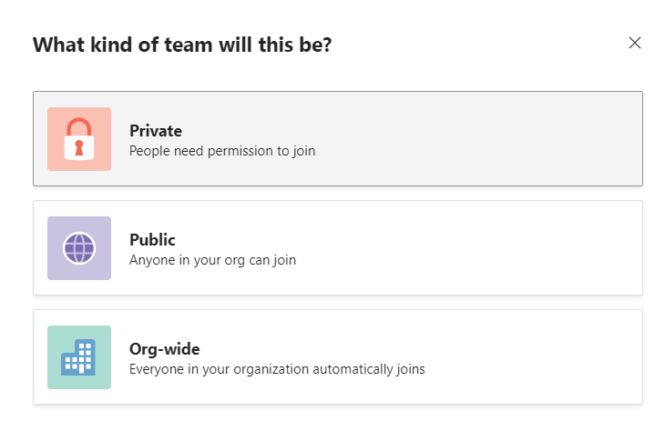
Options for Creating a New Team
It's best to create team from scratch
Team can be created as private, public or Org-wide

Slide 7
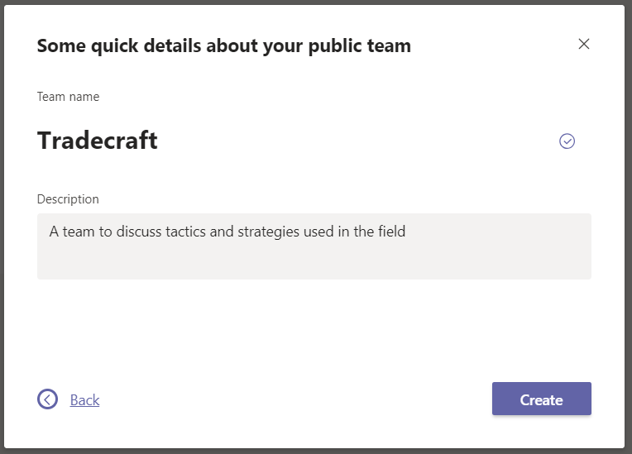
Assign Team Name and Description

Slide 8
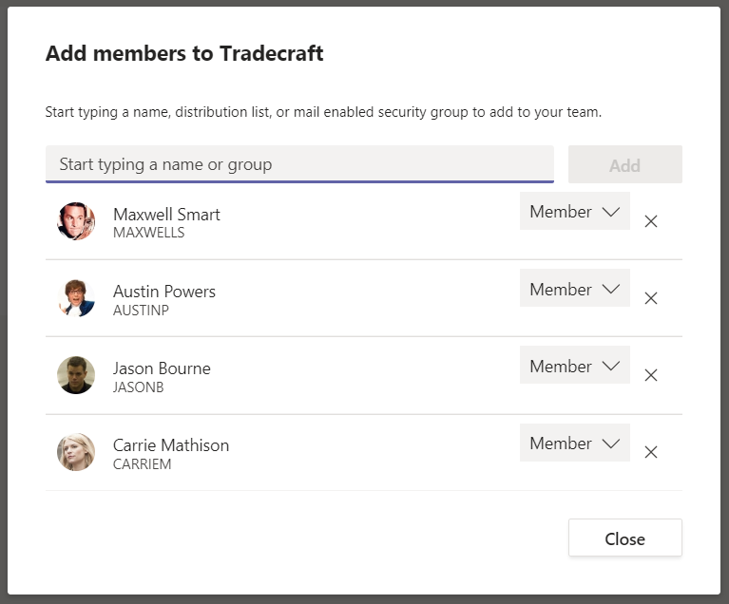
Add Team Members

Slide 9
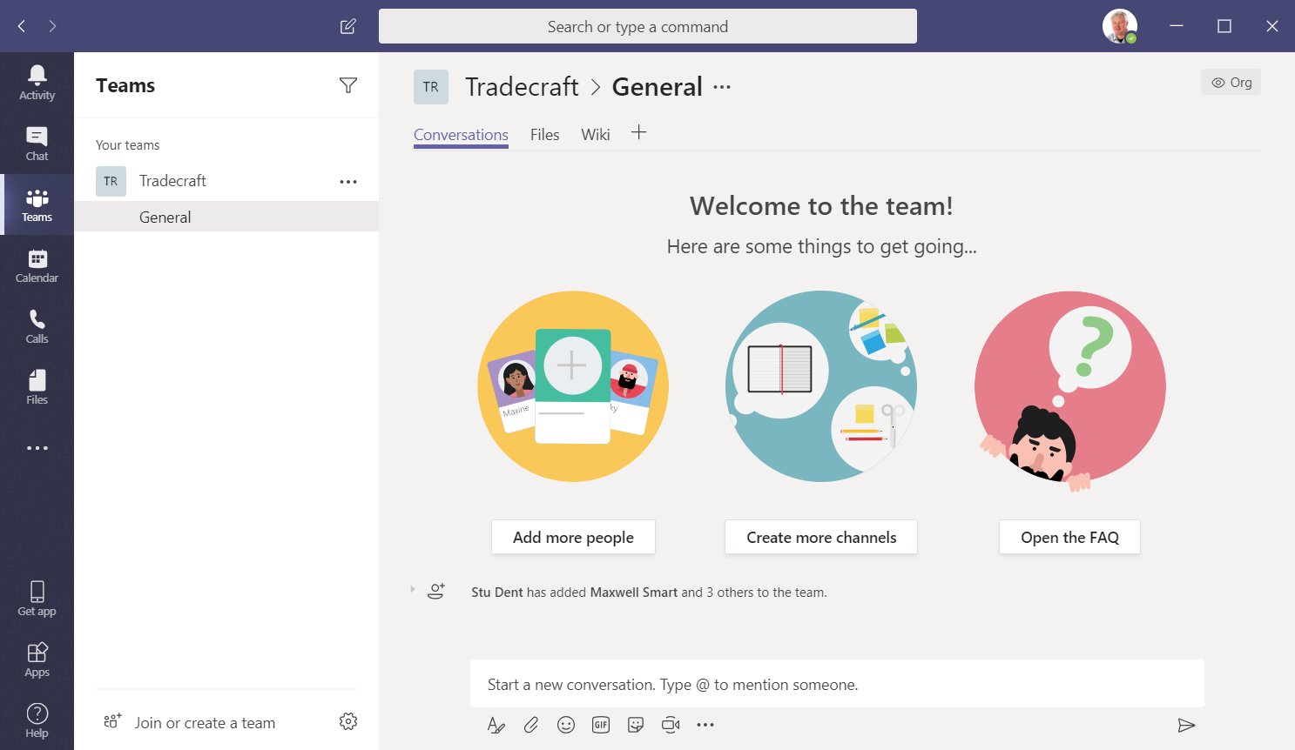
A Team is Born
General channel automatically added to each new team

Slide 10
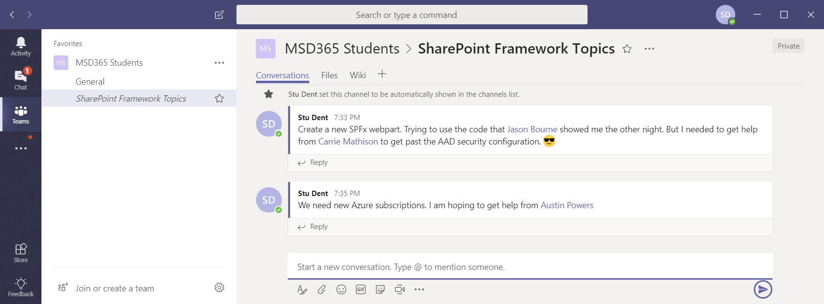
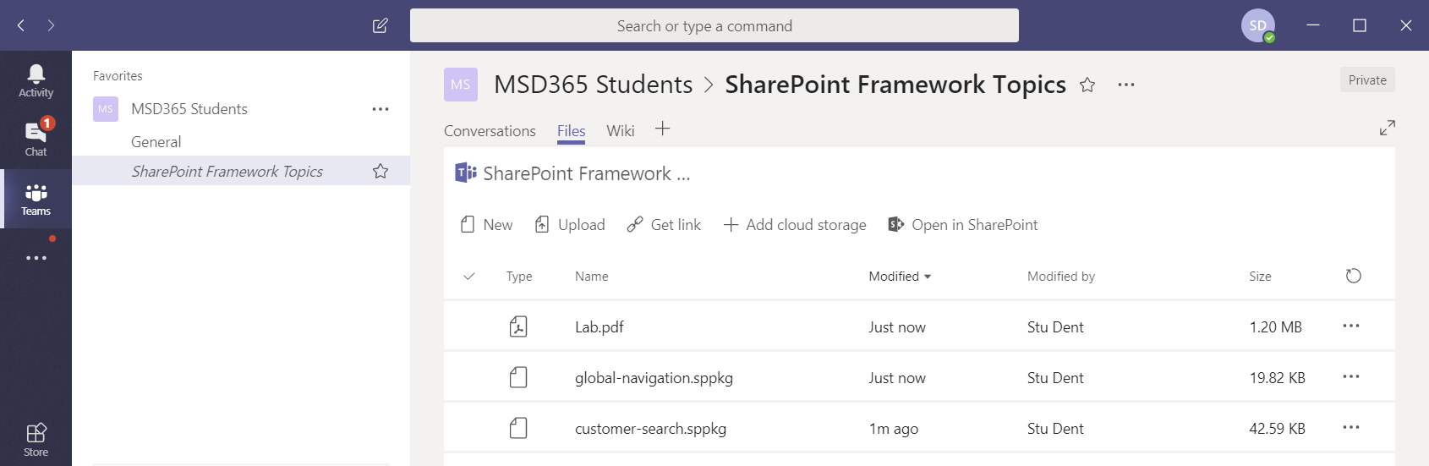
What's Inside a Channel?
Threaded conversations
Files collection (i.e. document library)

Slide 11
Adding Tabs

Slide 12







Microsoft Teams Development Platform
Development features available today
Tabs - surface rich content within Teams
Bots - help users get tasks done in conversations
Connectors - post rich updates to channels
Development features in preview
Actionable Messages - add rich interaction to connector cards
Activity Feed - engage users via feed notifications
Compose Extensions - users query & share cards in conversations
Office Store - drive engagement by submitting app to Office Store

Slide 13
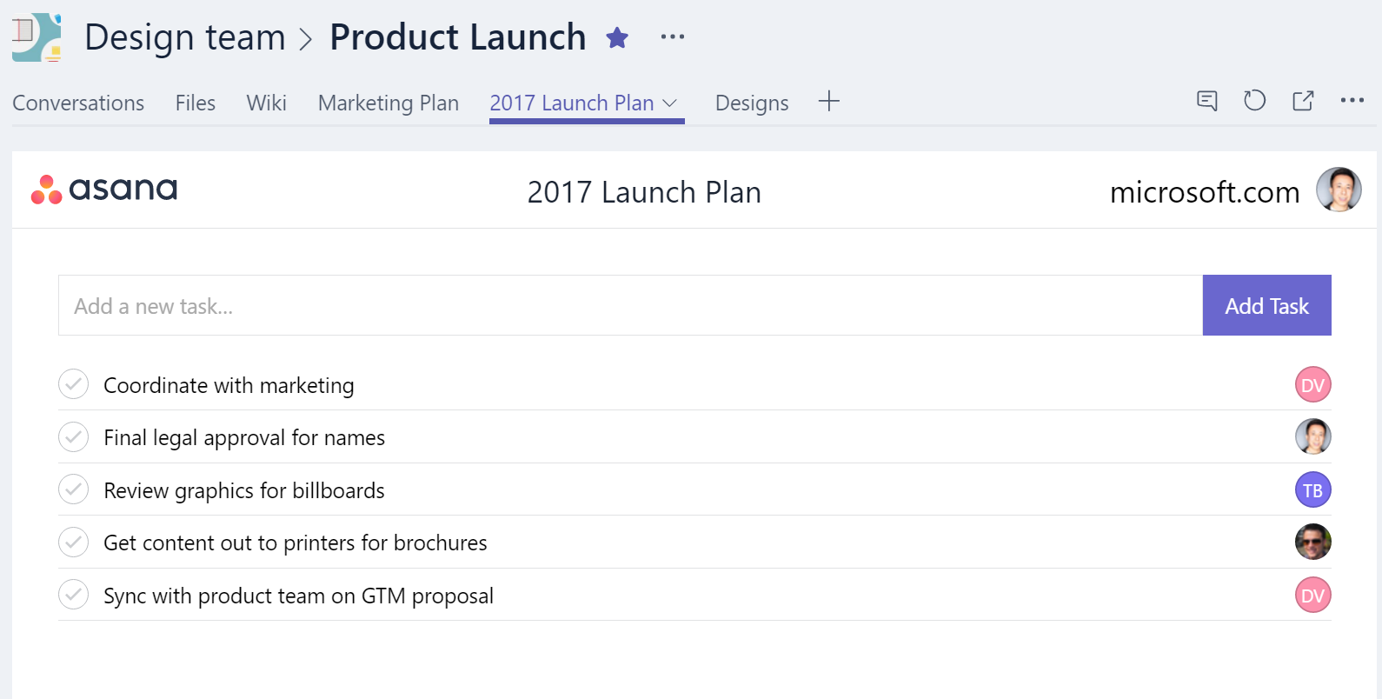
Developing Tabs
Rich surface area for your app
As simple as hosting your existing web app
Team productivity: within channels
Personal productivity: app flyout
Your services, experience, & users

Slide 14
Tabs
Embed-ready web UX on web/desktop, deep link to native apps on mobile
Leverages Microsoft Teams Tab Library javascript for context and interactivity
Team or Personal Scope

Slide 15
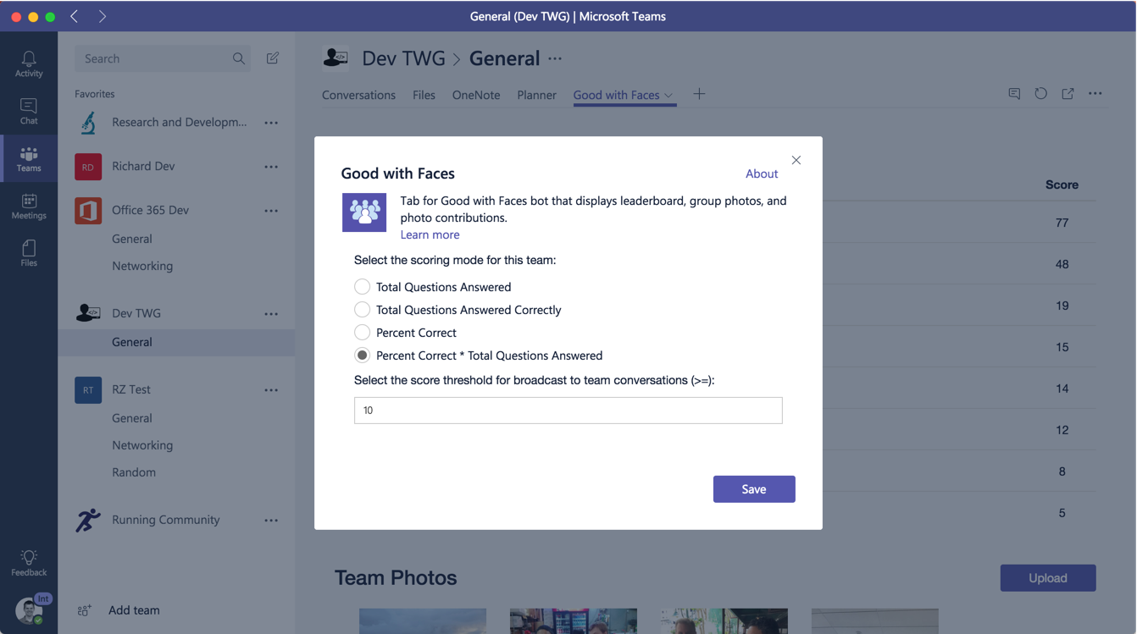
Tabs Pages
Configuration Page
used to add/update tab and set content page
Content Page
the primary page displayed in the tab
Remove Page
optional page displayed when a tab is removed

Slide 16
Tabs - Config Page
Used to Add or Edit a Tab
Must reference Microsoft Teams Tab Library
Sets the contentUrl for the tab
Calls setSettings to save tab configuration
Must call setValidityState to enable the save button
Call notifySuccess when saved
microsoftTeams.initialize();
microsoftTeams.settings.registerOnSaveHandler(function(saveEvent){
microsoftTeams.settings.setSettings({
entityId: "someid",
contentUrl: "https://somedomain/tab.html",
suggestedDisplayName: "Tab Title",
websiteUrl: "https://somedomain/info.html",
removeUrl: "https://somedomain/tabremove.html"
});
saveEvent.notifySuccess();
});
function onSaveClick() {
microsoftTeams.settings.setValidityState(true);
}

Slide 17
Tabs - Context information
getContext returns team/channel context:
tid – id of tenant
groupId – id of the O365 group
teamId – id of the team
channelId – id of the channel
entityId – id of the entity
theme – theme of the teams client
locale – the locale of the client
upn – UPN of the user
microsoftTeams.getContext(function (context) {
// context contains all context info
});

Slide 18
Tabs - Deep linking to Entities
Share a Link from your Tab
Trigger creation of deep link to specific Entity for user to copy and paste into a conversation
Resultant link may be clicked on by any user to launch the tab and navigate directly to that Entity
Programmatically create your own link, for use via bot or other code flows
microsoftTeams.shareDeepLink({
subEntityId: <subEntityId>,
subEntityLabel: <subEntityLabel>,
subEntityWebUrl: <subEntityWebUrl>
})
https://teams.microsoft.com/l/entity/<appId>/<entityId>?webUrl=<entityWebUrl>&
label=<entityLabel>&
context=<context>

Slide 19
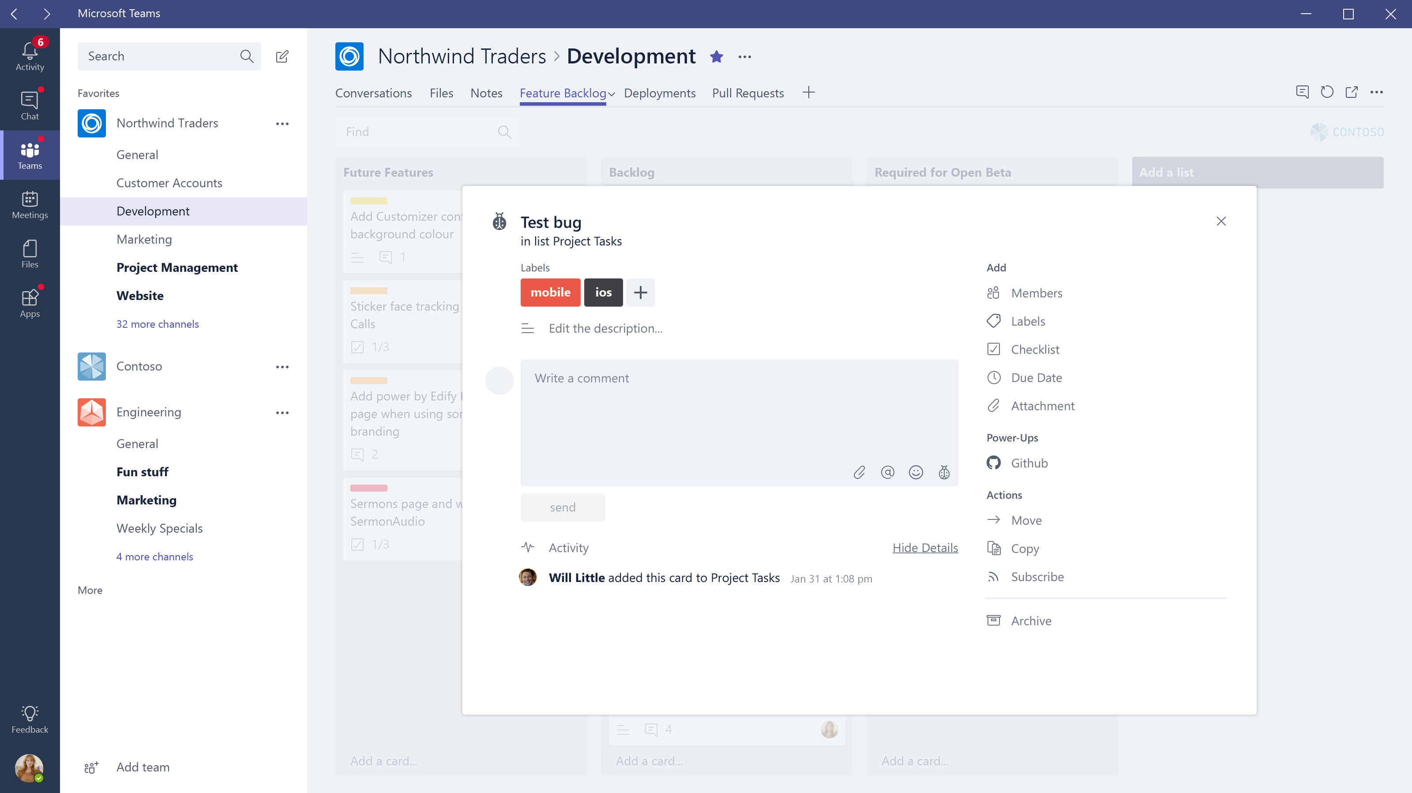

Slide 20
Building a Great Tabs experience
Configurable Tabs
In channel, tabs allow user to configure view to relevant content
Content should be the same for all users – leverage collaboration
Content should be locked – don’t allow users to browse away
Static Tabs
In personal scope, this content should be the relevant for either the all-up app (e.g. Help, FAQ, forums) or for a personal view of the experience

Slide 21
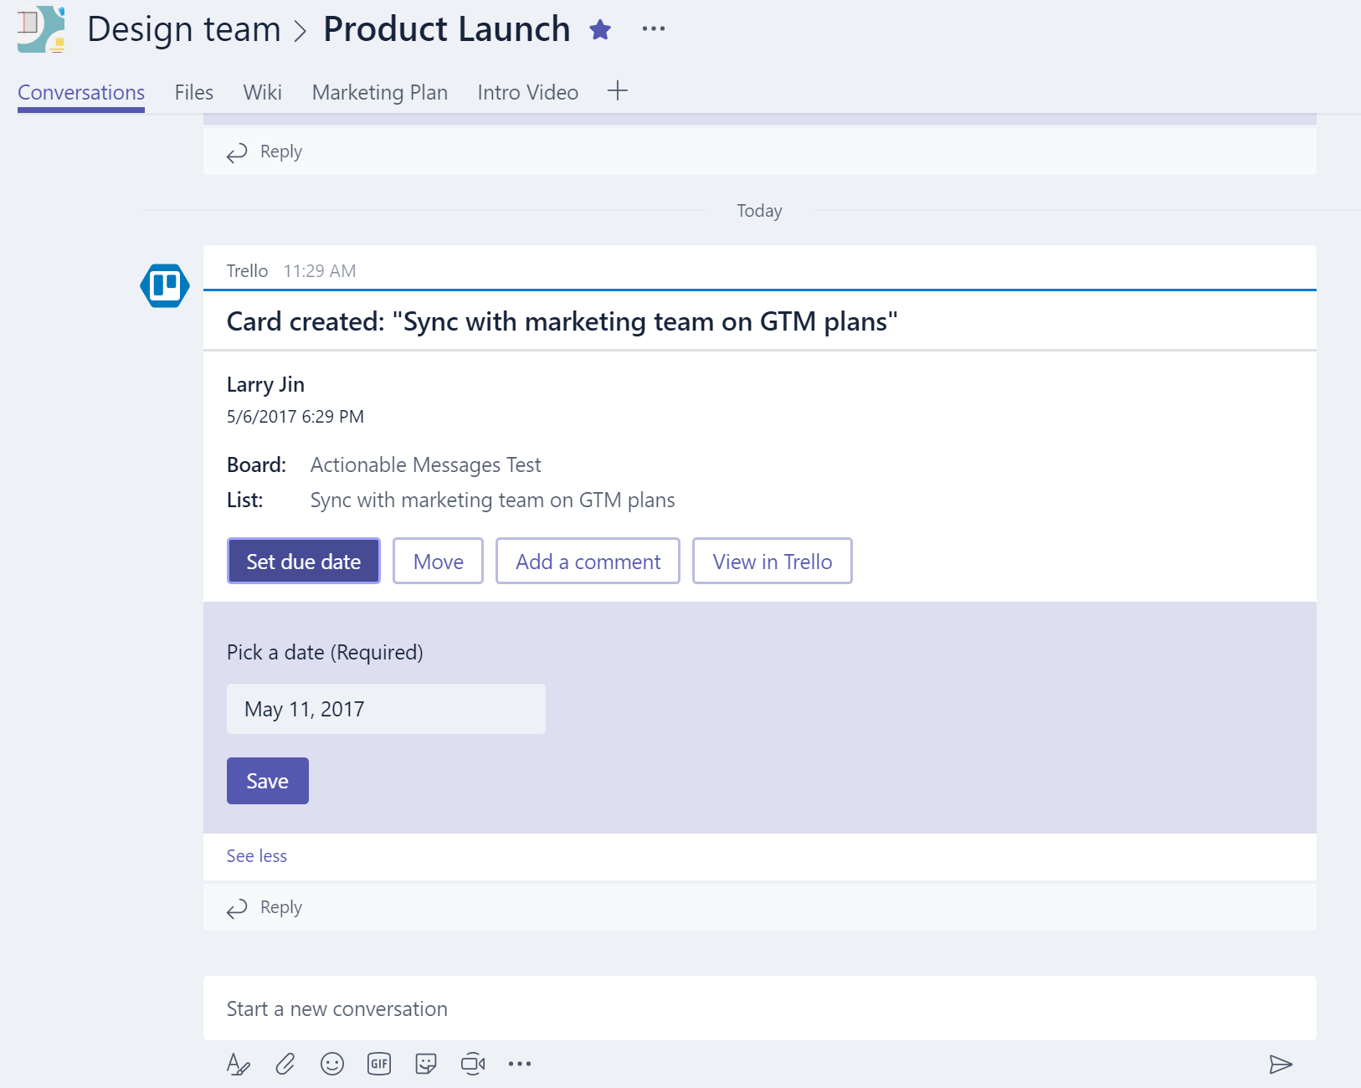
Connectors with Actionable Messages
Push rich interactive cards into channels
Fully supported in both Teams and Outlook
Users can take quick actions (e.g. comment or set a date)
Uses incoming webhook API

Slide 22
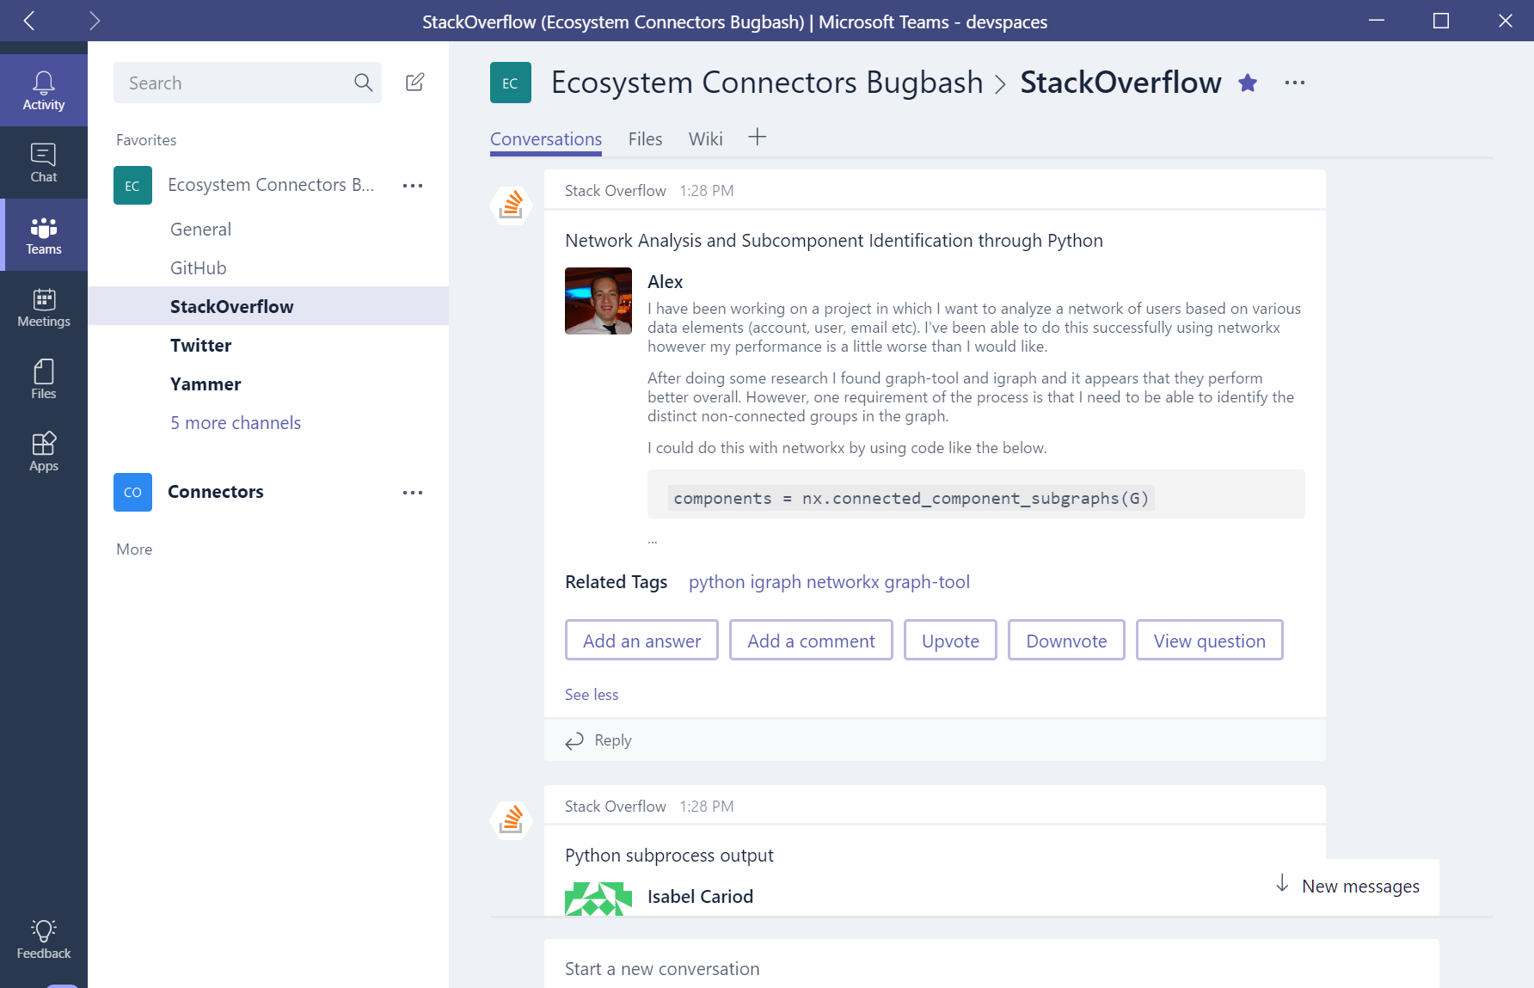
Office 365 Connectors
Leverage webhooks to send activity into Teams
Build connector, registering on the Connector Developer Portal
Simply add Connector ID to manifest.json
Leverage Actionable Messages to allow inline work commands

Slide 23
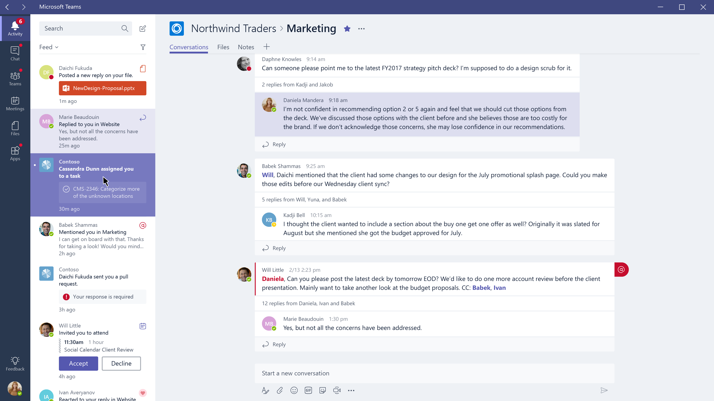

Slide 24
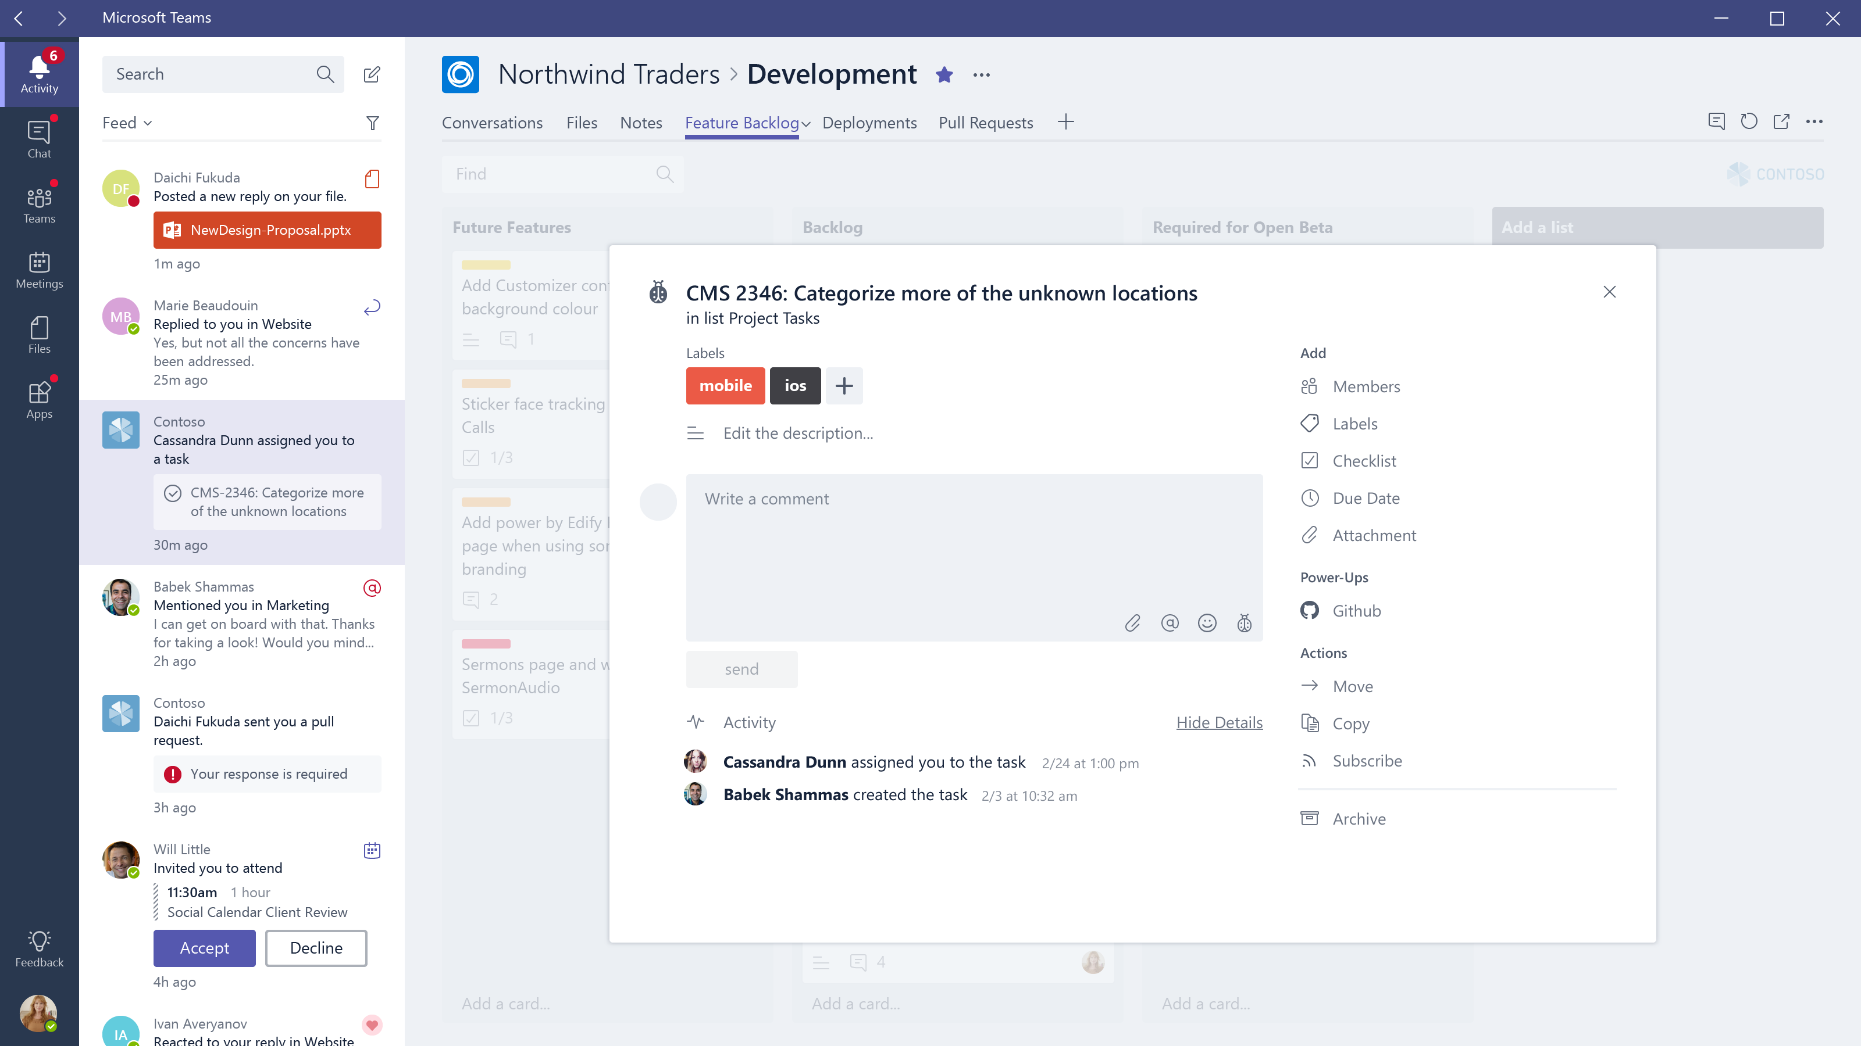

Slide 25
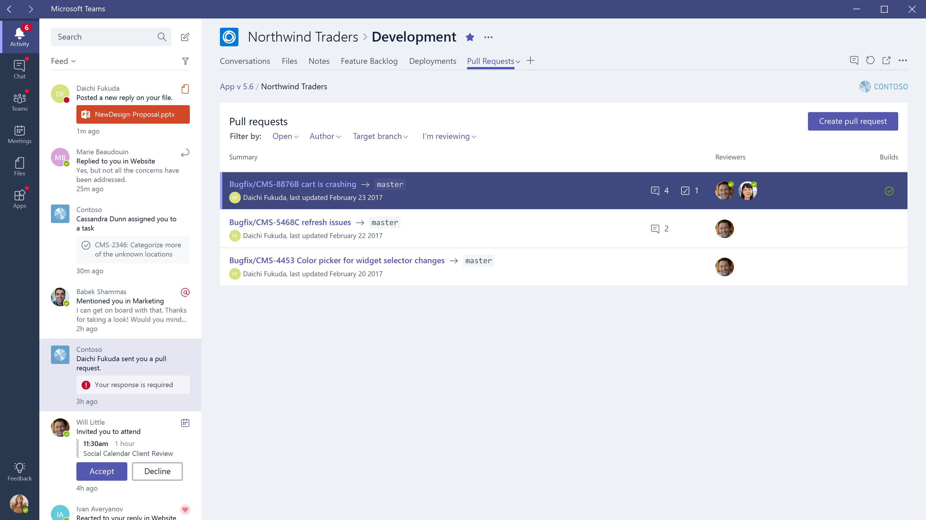

Slide 26
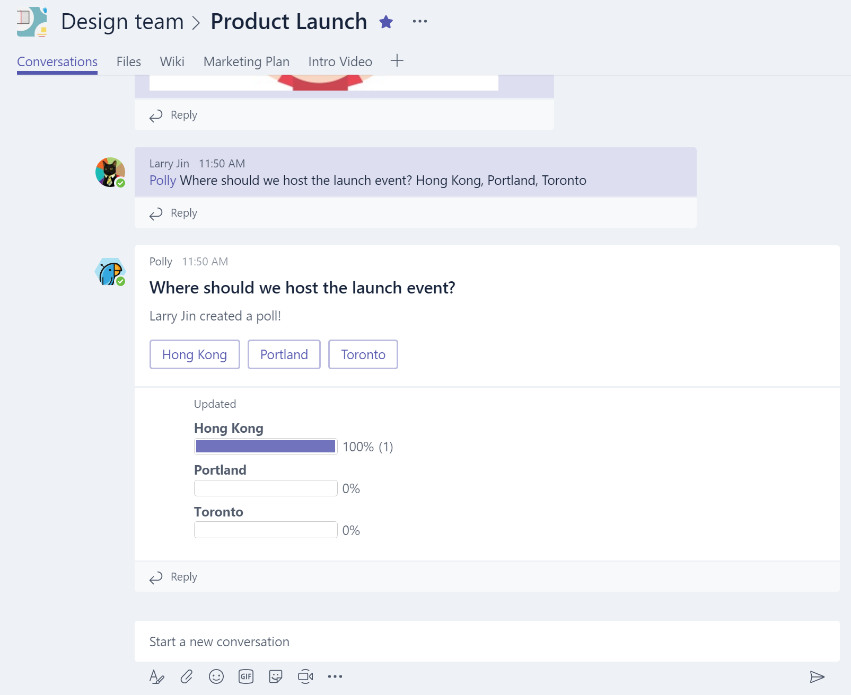
Bots
Bot is app with automated interaction in Team with conversations or 1:1
Built using Microsoft Bot Framework
Complete tasks via basic commands, menu or natural language
Rich Microsoft Teams features, e.g.
Input menus
Dynamic message updates
Integrate with tabs

Slide 27
Bots
Based on Web Service you create and host
Use whatever web technology you prefer
Extra support for using Node.js or .NET on Azure
Built using Microsoft Bot Framework
Call REST APIs directly or use libraries for Node.js and .NET
New Microsoft Teams Extension libraries (Node.js and .NET) provide channel-specific functionality

Slide 28
Bots – Getting up and running
Set up basic development environment
Install Bot Builder
Install Microsoft Teams extension SDKs for chosen language
Leverage existing samples
Bot Framework sample
Teams Getting Started sample
Run locally to test in the Bot Emulator

Slide 29
Bots - Getting Teams-ready
Register your bot in the Bot Framework Dev Portal
Set a unique bot name and handle
Set your bot Endpoint – your hosted domain, or your debug instance (we recommend Ngrok)
Create an AppID (aka BotID) and Password
Add Microsoft Teams as a Channel
Note: for 1:1 bot, you may reference your bot directly via its AppID
Enter your AppID and Password into your Development environment
Build and publish or run locally with Ngrok

Slide 30
Bots - Accessing in Teams
{
"manifestVersion": "1.0",
"version": "1.0.0",
“id": "%APP_GUID%",
"packageName": "com.samples.samplebot",
"developer": {
"name": "Microsoft",
"websiteUrl": "https://www.microsoft.com",
"privacyUrl": "https://www.microsoft.com/privacy",
"termsOfUseUrl": "https://www.microsoft.com/termsofuse"
},
"name": {
"short": "Sample Bot App"
},
"description": {
"short": "This is a sample bot manifest",
"full": "This sample bot manifest has minimum info."
},
"icons": {
"outline": "contoso20x20.png",
"color": "contoso96x96.png"
},
"accentColor": "#60A18E",
"bots": [
{
"botId": "%BOT_FRAMEWORK_ID%",
"scopes": [
"team",
"personal"
]
}
],
"permissions": [
"identity",
"messageTeamMembers"
]
}
Create a Teams App Manifest
Microsoft provides SimpleBot package
SimpleBot has manifest with sample icons
Add your BotID in the Bots object
Sideload into a Team

Slide 31
Bot - Messaging
Responsive messages (via 1:1 or @mentioning in channel)
Proactively create messages
Create direct (1:1) message – must know user ID
Create new channel reply – bot must be added to team and know channel information
Update messages sent by Bot
One-way only – e.g. push notifications

Slide 32
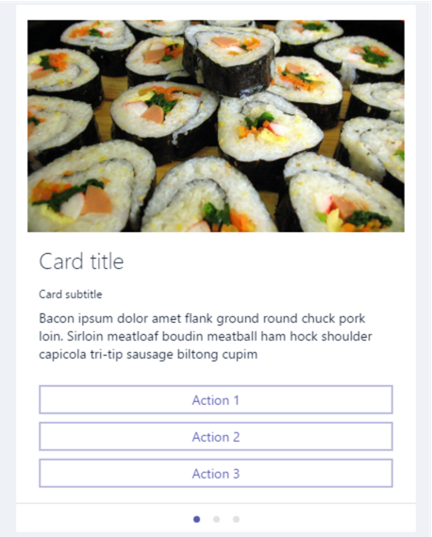
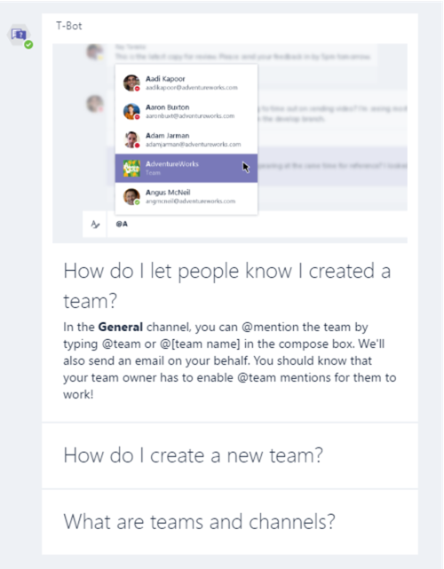
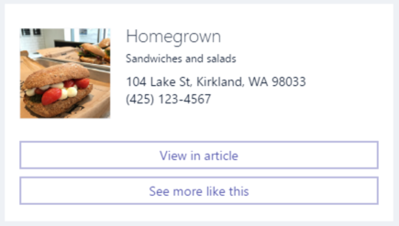
Bot - Content
User to bot
Plain or rich text
Inline images
Note: files not currently supported
Bot to user
Plain text
Markdown or XML
Cards
Hero Cards
Thumbnails
Sign-in
Carousel or List layouts
Buttons
openUrl – open in browser
imBack – trigger chat response
invoke – silent JSON payload

Slide 33
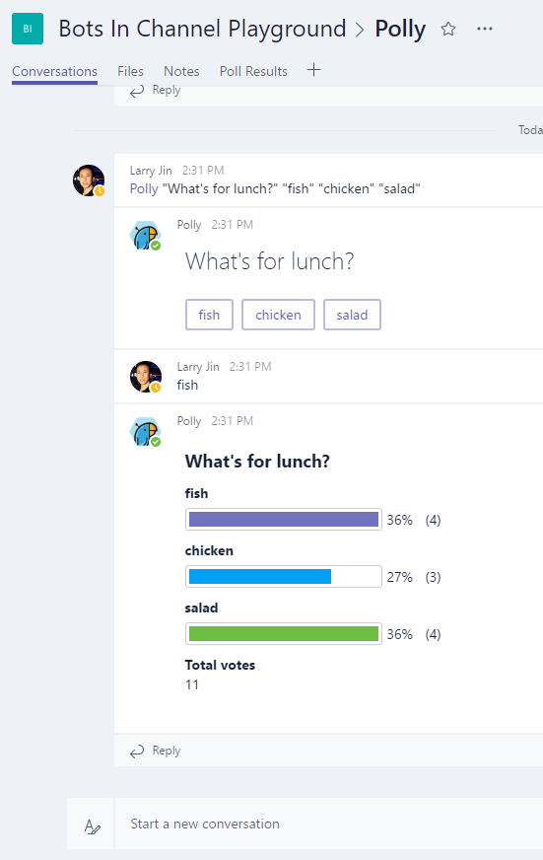
Bots in Team Channels - Basics
Bot only listens to @mentions
Replies go to the conversation thread
Inbound payload in channels as flagged as isGroup and contains Teams channel data:
"channelData": {
"channel": {
"id": "19:293ecdb923ac4458a5c23661b505fc84@thread.skype",
},
"team": {
"id": "19:293ecdb923ac4458a5c23661b505fc84@thread.skype"
},
"tenant": {
"id": "72f988bf-86f1-41af-91ab-2d7cd011db47"
}
}

Slide 34
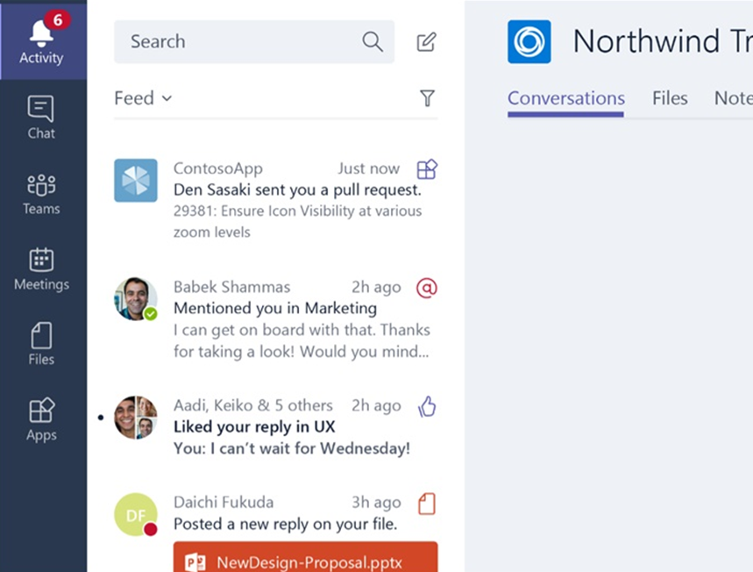
Activity Feed
Notify users personally via the activity feed
Same API as sending bot messages
Deep link straight into tabs

Slide 35
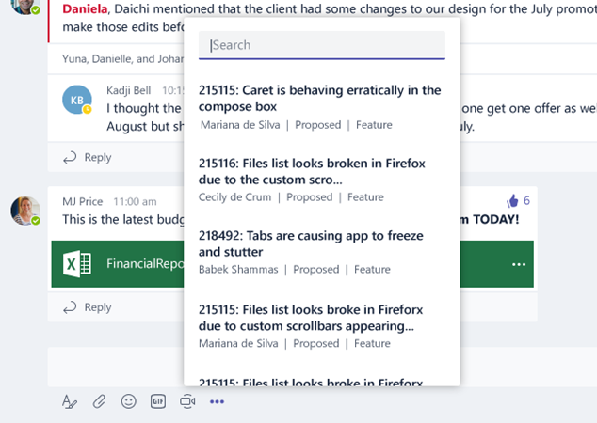
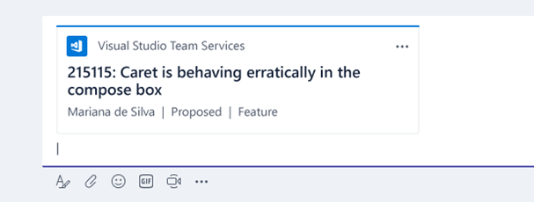
Compose Extensions
Personalize Teams Compose box with your App & Services content
Users can query and insert your app content into conversations
Example: Bug details from VSTS
Example: Sales opportunities from CRM
You can reuse services you built for Bots or Tabs

Slide 36
Microsoft Teams App
Microsoft Teams Apps
Deliver custom solution using solution package (.zip)
Single App definition – manifest.json
Single package used for Sideloading or Office Store

Slide 37
Building a Great Microsoft Teams app
Teams Scope - your experience exists in the team context
Team owners may add your experience to a team:
Bots and Compose Extensions – available on all channels
Teams Tabs (“Configurable”) – added and customized on a per-channel basis
Personal Scope – your experience exists in individual user context
Individuals add the experiences they want for personal use
Bots and Compose Extensions – available in 1:1 chat
Personal Tabs (“Static”) – available to end users via the App bar or alongside 1:1 bots

Slide 38
Getting Started
Tabs - Bring your own Service
JavaScript APIs to tie your experience to Teams context
Connectors – Leverage the Connectors Developer Portal
Use new Actionable Cards layouts that work in Outlook and Teams
Bots – Build using the Bot Framework
Use the .NET and Node.js SDKs, or call the REST endpoints
Teams Extension SDKs provide Teams-specific functionality
Flag important messages for inclusion in Activity Feed
Compose Extensions – Reuse your bot
Use the .NET and Node.js SDKs, or call the REST endpoints
Teams Extension SDKs provide Teams-specific functionality

Slide 39
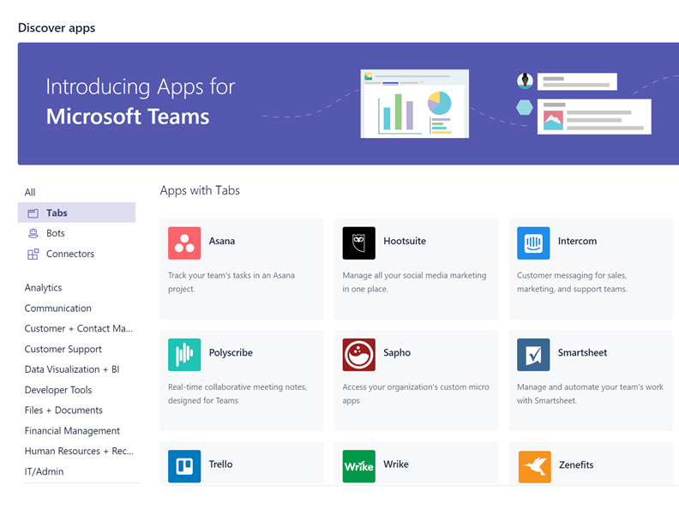
Deploying
ISVs – Distribute through the Office Store
Create or use your existing DevCenter/Seller Dashboard account
Upload your package and enter your product page metadata
Office Store Validation ensure compliance with Office Store Policy
Validated apps published to Office Store appear in Microsoft Teams Discovery view
Line-of-Business apps – Sideload your package
Leverage the same testing methodology to deploy within your org

Slide 40
Compose Extensions
Service that listens to user requests and returns cards or rich media
Leverage the Bot you’ve already built, or build another
Define commands and parameters in the manifest.json
Handle via Bot Framework activity, leveraging the Microsoft Bot Extension SDKs
"composeExtensions": [
{
"botId": "57a3c29f-1fc5-4d97-a142-35bb662b7b23",
"scopes": [
"personal"
],
"commands": [{
"id": "searchCmd",
"description": "Search Bing for information on the web",
"title": "Search",
"initialRun": "true",
"parameters": [{
"name": "searchKeyword",
"description": "Enter your search keywords",
"title": "Keywords"
}]
}
]
}
],

Slide 41
Building a Compose Extension Experience
Compose Extensions in Microsoft Teams
Share content that makes sense in conversations.
Add on as part of core Bot offering to facilitate easier management.
Take advantage of the rich card types provided as part of the platform.
Optimize search results to keep compose extensions snappy and responsive.

Slide 42
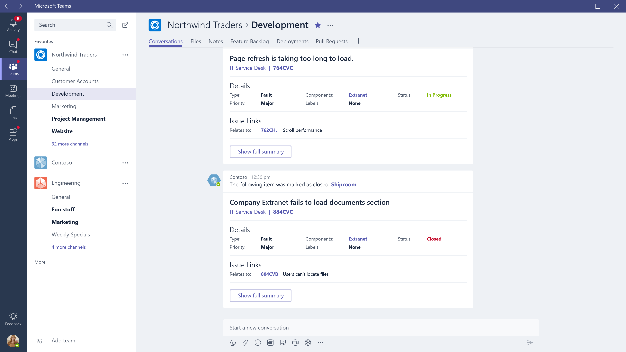

Slide 43
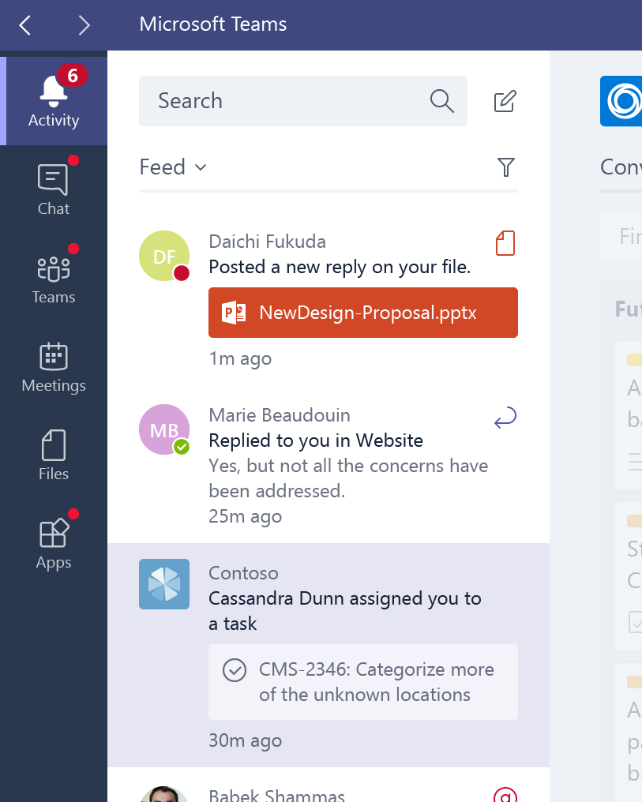
Activity Feed
Use the Activity Feed to send important information to your users
Leverage existing Bot to tag specific messages as notification alerts
Encode deep link to entity (tab) for one-click navigation to content

